Slide 1

EXCEL PROJECT
Stock Market
CRUD
VBA
Portfolio Tracker
Operations
Macros
& Return Analyzer
5
100%
Data Sheets
No DB Needed
A comprehensive Excel solution for tracking investments, analyzing returns, and cleaning raw stock data.
👤 Sarthak Mukherjee & Surojit Jana

Slide 2
Project Overview
A fully-featured Excel workbook for Indian stock market investors to track portfolios, calculate returns, and manage raw data — powered by VBA macros.
📊
Portfolio Tracking
📈
Return Analysis
Log every trade with broker, stock, sector, quantity and buy price in a structured table.
Calculate P&L, percentage returns and total portfolio value automatically.
🧹
Data Cleaning
🔍
Search & Filter
Remove duplicates, delete blank rows, and standardise data using VBA macros.
Filter stocks by broker, sector, portfolio type and date using Excel slicers.

Slide 3
Key Features
➕
👁
✏️
Add Stocks
View Portfolio
Edit Records
Enter new trades with all details — date, stock, sector, broker, price, quantity.
See your entire portfolio in a clean formatted table with colour-coded priorities.
Update existing entries for price changes, quantity adjustments, or corrections.
🗑
🔎
📉
Delete Entries
Search & Filter
P&L Calculation
Remove unwanted or outdated trades with a single click using VBA.
Find stocks by name, broker, sector or portfolio type instantly.
Auto-calculate profit/loss per stock and total portfolio return in percentage.

Slide 4
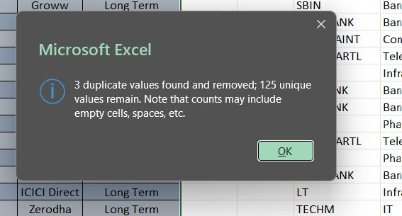
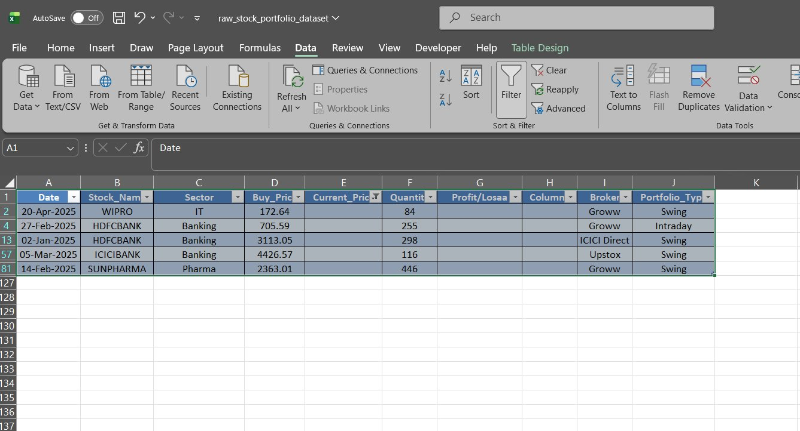
Data Cleaning — Screenshots
Remove Duplicates — Result Dialog
Raw Dataset — After Blank Row Deletion
3 duplicates found & removed · 125 unique values remain
Data tab → Remove Duplicates · Blank rows auto-deleted via VBA

Slide 5
Data Cleaning — Steps
01
Remove Duplicates
Used Excel's built-in Remove Duplicates tool under the Data tab. Detected 3 duplicate rows across 128 entries, leaving 125 unique records.
02
Delete Blank Rows
VBA macro scanned all rows from the bottom up and deleted any row where column A (Date) was empty, keeping data contiguous.
03
Standardise Columns
Fixed column header typo: 'Profit/Losaa' corrected to 'Profit/Loss'. Blank columns H removed. Data types verified for Date and numeric fields.
04
Validate Data Types
Buy_Price and Current_Price columns formatted as Number (2 decimal places). Date column formatted as DD-MMM-YYYY for consistency.

Slide 6
Project Structure — Excel Sheets
📄
raw_stock_portfolio_dataset
Main data table — all raw trade records (128 rows × 10 columns)
📄
Portfolio Summary
Aggregated view — total investment, current value, overall P&L
📄
Return Analyzer
Per-stock return % and profit/loss calculated from buy vs current price
📄
Macros Sheet
Hosts all macro buttons: clean data, delete blanks, remove duplicates
📄
Charts Dashboard
Visual charts — sector allocation pie, broker split, P&L bar chart

Slide 7
CRUD Operations via VBA
CREATE
➕ /add (macro button)
Fill form → click Add → new row appended to dataset table automatically
READ
👁 / (portfolio view)
Home sheet displays all records with auto-formatting and colour coding
UPDATE
✏️ /edit (select row + edit)
Select any row → modify cell values → VBA validates and saves changes
DELETE
🗑 /delete (macro button)
Select row → click Delete button → row removed and IDs re-sequenced

Slide 8
Dataset Columns
Column Name
Description
Data Type
Color
Date
Trade entry date
DD-MMM-YYYY
Stock_Name
Company name / ticker
Text
Sector
Industry sector
Text
Buy_Price
Purchase price per share
Number (₹)
Current_Price
Today's market price
Number (₹)
Quantity
Number of shares held
Integer
Profit/Loss
Calculated gain/loss (₹)
Formula
Broker
Trading platform used
Text
Portfolio_Type
Trade style
Swing/Intraday/Long Term

Slide 9
Tools & Technologies
📊
⚙️
🧮
Microsoft Excel
VBA (Macros)
Excel Formulas
2016/365
Excel VBA
Advanced
Primary platform for data entry, tables, and charts
Automates data cleaning, CRUD operations and formatting
VLOOKUP, IF, SUMIF, conditional formatting used throughout
📉
🔢
🗃
Excel Charts
Power Query
Data Tables
Native
Get & Transform
Structured Ref
Bar, pie and line charts for portfolio visualisation
Used for connecting and refreshing external data sources
Excel tables (ListObjects) for structured data referencing

Slide 10
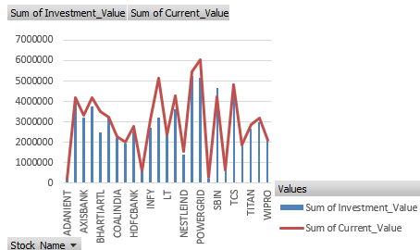
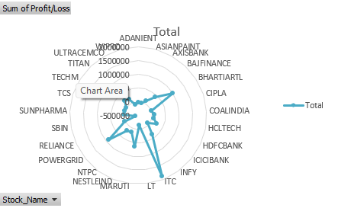
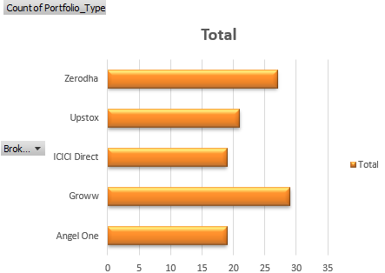
VISUALIZATION

Slide 11
Project
Summary & Learnings
✅ Built a complete CRUD-enabled stock portfolio tracker in Excel
✅ Automated data cleaning with VBA: duplicates removed, blanks deleted
✅ Analysed 125 unique trade records across multiple brokers and sectors
✅ Created dynamic return analysis with profit/loss calculations per stock
✅ Designed a clean, professional dashboard using Excel charts & slicers
👤 Sarthak Mukherjee & Surojit Jana | Excel Project

